Slide 1



X
Logo Company
Machine Learning : Regression & Clustering
Data Scientist at Kalbe Nutritionals
Presented by
Imam Ahmad Qusyairi

Slide 2
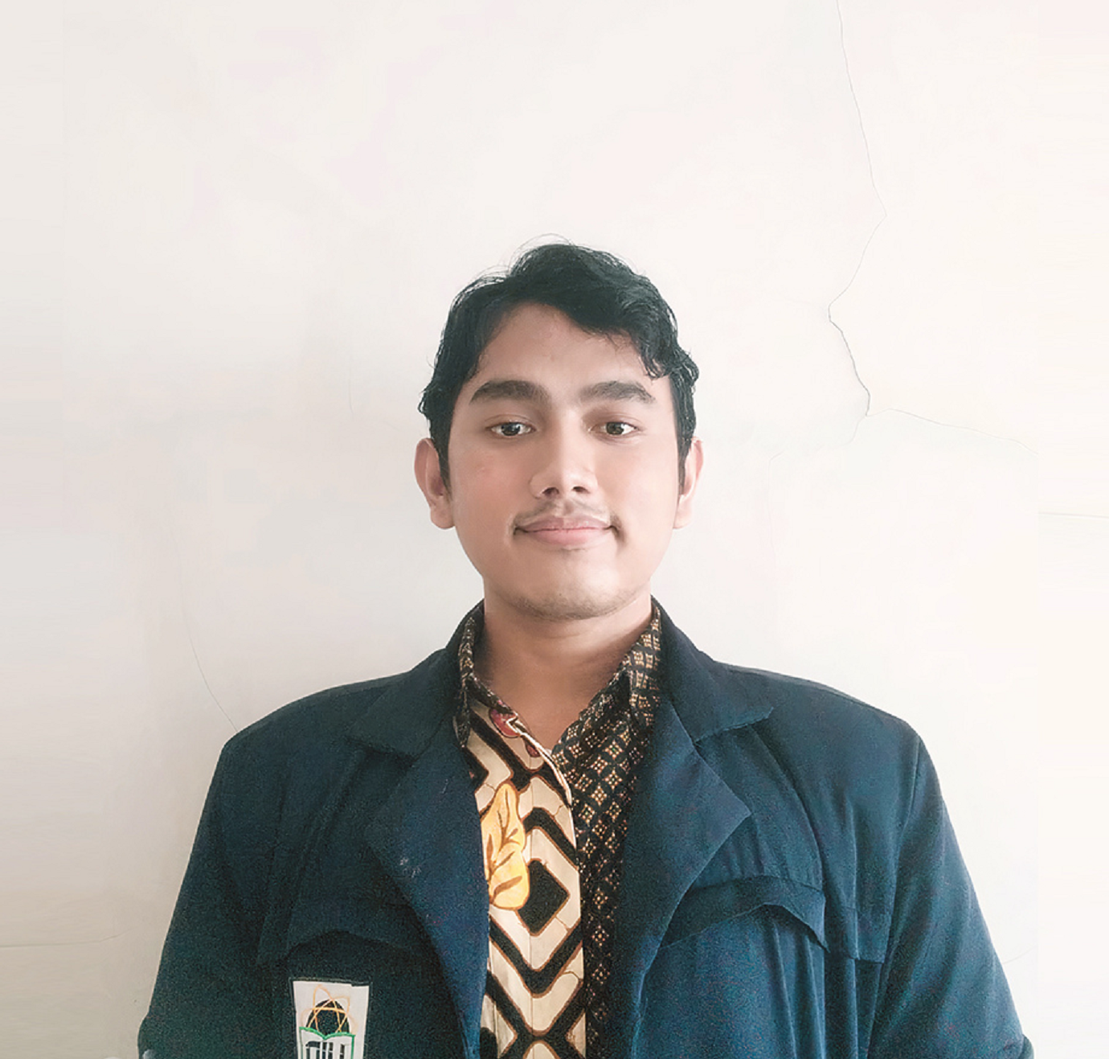

Imam
Ahmad Q
Social Media
E-mail
Imam.aqusairi@gmail.com
About You
Phone
(+62) 85892648708
Data enthusiast with education background in public health concentrating on biostatistics. Has experience managing a large dataset consisting of 18.000 rows and developing machine learning model with precision score 89%. Currently finished several training & certifications program on data science. Possess extensive skills in data management, analysis, visualization & modelling. He adepts at providing valuable insights. Able to work collaboratively with a cross-functional team and has good presentation skills.
Linkedin
linkedin.com/in/imamaq/
Github
github.com/imamaqusairi

Slide 3




Working Experiences
Data Scientist Intern at CRM (Kalbe Nutritionals)
Develop 3 different machine learning models for marketing team & business solutions. Built model through multiple experimentation and different preprocessing process. Built machine learning model with precision score 89%
Participate in survey analysis effort for clients. Introduced 3 new analysis insight to the team
Build python-based Graphical User Interface (GUI) for ML modelling to increase data team productivitity and minimize human error
Clients's data project i've been working on : Benecol, Entrasol & Morinaga (KN2 & KN3)
Data Science Class Coordinator at Rakamin Academy
Keep satisfaction score evaluation from student above 85% and above 95% from tutor. Held fun activities to increase motivation and provide sharing spaces where student could share their thoughts and complaints
Maintain assignment’s score above 85 out of 100 thorough the bootcamp. Motivate other students to explore data science topic broadly by providing additional resources and answering questions given by the students
Covid-19 Digital Tracer (Data Analyst) at Dinas Kesehatan DKI Jakarta
Manage large datasets consists of 18.000 Covid-19 patient data. Maintain high quality data on RT & RW level from missing & invalid data. Routinely coordinating with stakeholder
Introduce Spatial-based data visualization using QGis for improving more accurate decision-making effort for tackling Covid - 19 in local level. Involved on Covid-19 publishing effort on weekly basis

Slide 4
Case Study
Machine Learning Project : Regression & Clustering
Challenge 1 :
Help inventory team at Kalbe to help decision making process by developing forecasting on product demands using ARIMA
Challenge 2 :
Help marketing team performing personalized advertising treatment by Unsupervised Learning Kmeans Clustering

Slide 5
Insert Your Result Here
You can add image and details of your result. You can add an explanation of how you got the result also.

Slide 6
Insert Your Link Here
You can add link GitHub / Coda / Figma also (optional)

Slide 7
Video Presentation Here
Please insert your link video here (You can upload the video on YouTube or Google Drive first)!

Slide 8
Thank You
X

